Slide 1
BloodLife
Presented By: Gennaro Finelli & Karl Alvarado

Slide 2
Description Of The Project
BloodLife is a mobile application that allows its users to log into their accounts and register for any upcoming blood drives that are taking place.

Slide 3
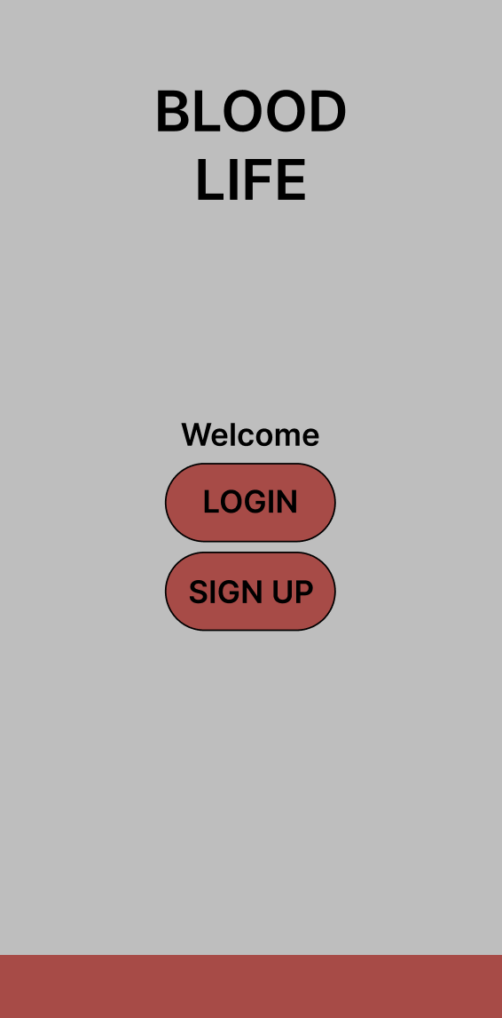
Start Page

Slide 4
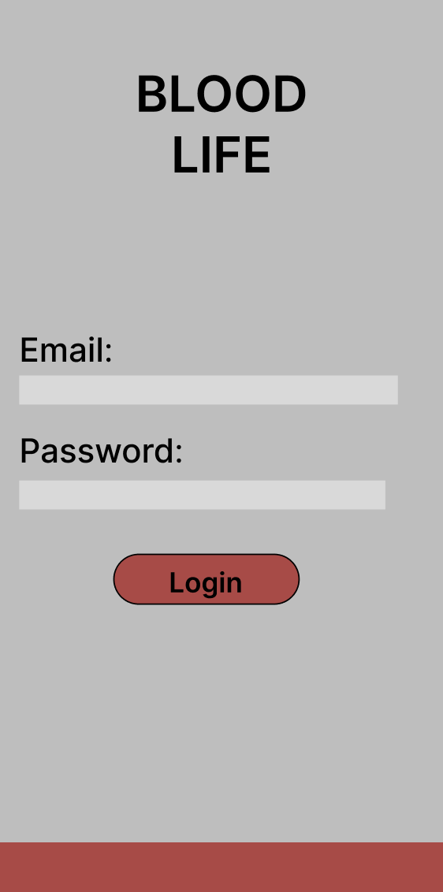
Login Page

Slide 5
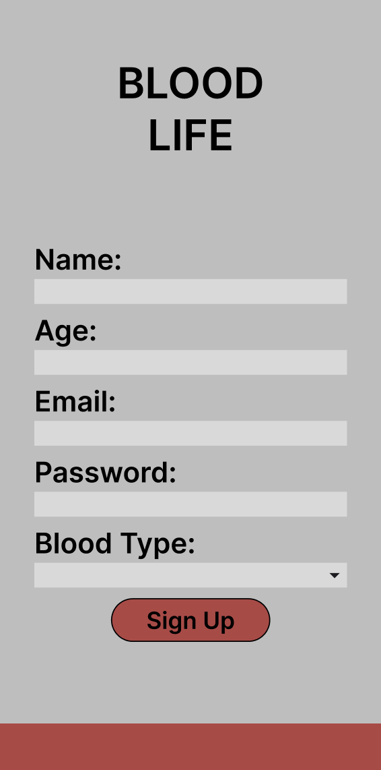
Sign Up Page

Slide 6
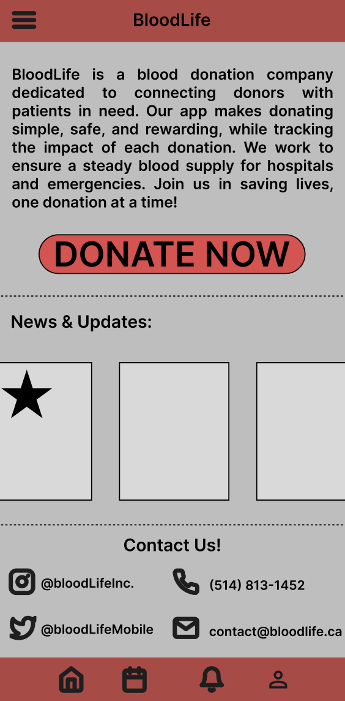
Home Page

Slide 7
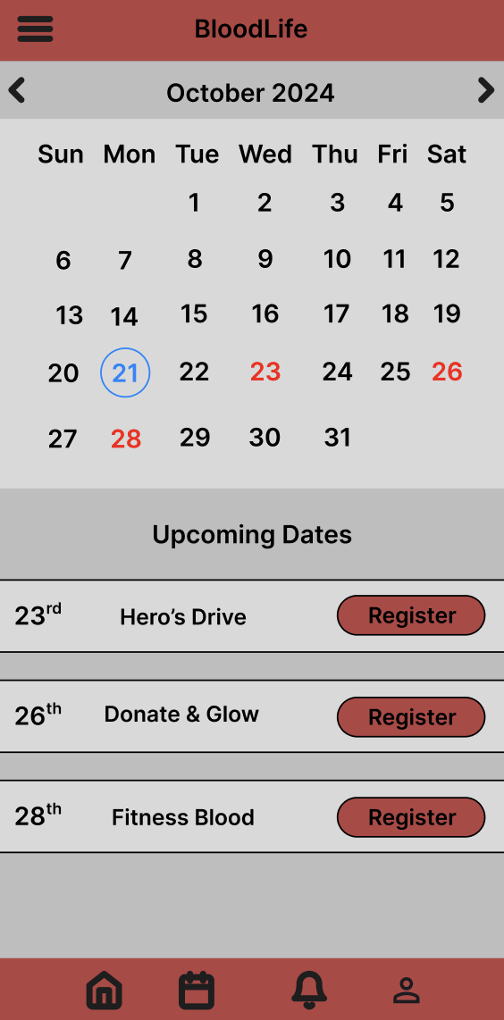
Booking Page

Slide 8
Notifications Page

Slide 9
Profile Page

